Slide 2
Piezo compensation algorithm for SC cavities at ESS
LLRF25 workshop
PRESENTED BY ANDERS SVENSON

Slide 3
Outline
ESS overview – Linac
Motivation – ESS case
ESS cold cavities – Spoke and elliptical (MB/HB) cavities
Power overhead
Piezo compensation system – Hardware overview
Algorithms overview
Offline char
Online
Results
Summary and future work

Slide 4
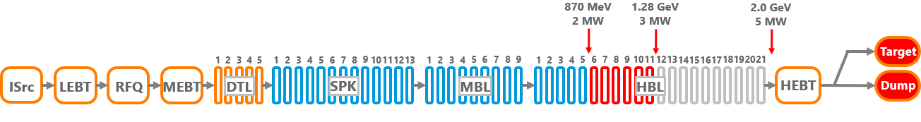
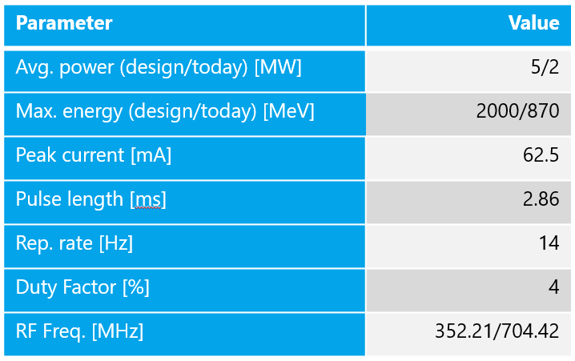
ESS overview
Timeline:
DTL4 Beam: April, 2023
Beam on Dump (BOD), 870 MeV: May, 2025
Beam on Target (BOT), 870 MeV: March, 2026

Slide 5
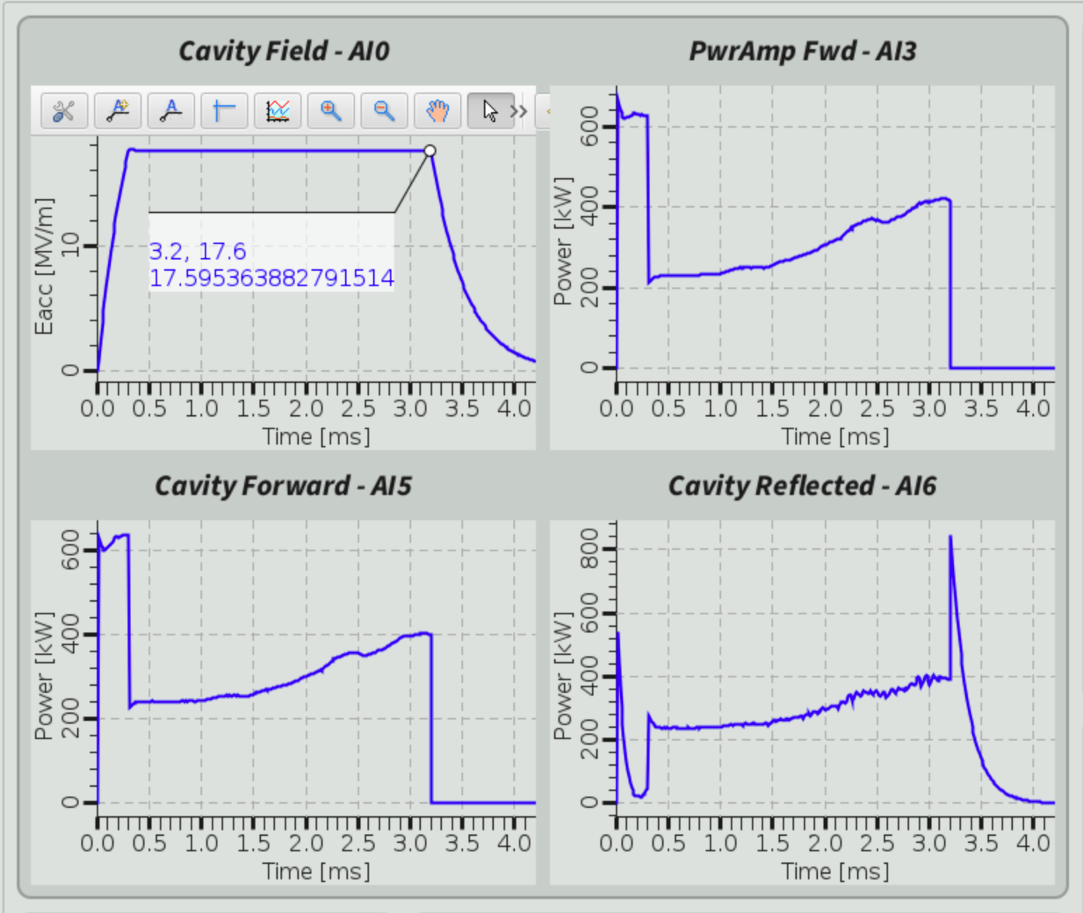

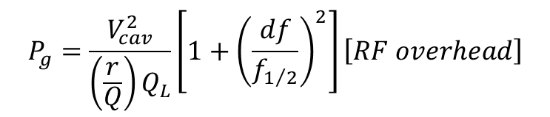
Motivation
ESS case
High gradient
Pulsed cavities (ESS pulse length 3ms)
Super-fluid helium
Lorentz force detuning (LFD) is the dominant source of cavity detuning.
Without compensation cavities can dynamically detune by several bandwidths.
Maintaining the accelerating gradient under these conditions would require considerable excess RF power.
FB loop overpower 1 BW = 2x power
$$P_{g}=\frac{V_{cav}^{2}}{\left(\frac{r}{Q}\right)Q_{L}}\left[{1+\left(\frac{df}{f_{1/2}}\right)}^{2}\right]\left[RF overhead\right]$$
$$df=−K_{LFD}∗{\left|V_{cav}\right|}^{2}$$
Beam
LFD
RFDS + LLRF

Slide 6
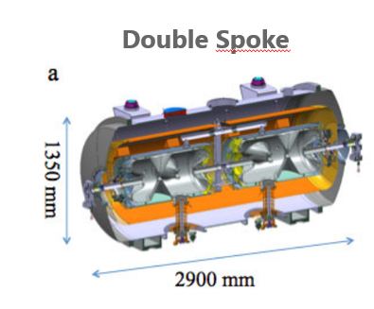
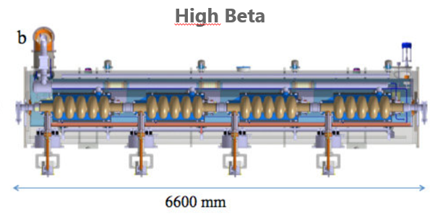
Cavities and excess power
Without LFD compensation
Cavity parameters:
Cavity | Nominal Eacc [MV/m] | Q_{L} [x10^5] | K_{LFD} [Hz/(MV/m)²] | Detuning [Hz] | F_{1/2} [Hz]
Spoke | 9.0 | 2.0 (1.5 to 2.3) | -4.4 to -5.1 | -356 to -413 | 880
Medium Beta | 16.7 | 7.5 (6.0 to 8.5) | -2.0 | -569 | 470
High Beta | 19.9 | 6.6 (5.8 to 7.3) | -1 | -396 | 530

Slide 7
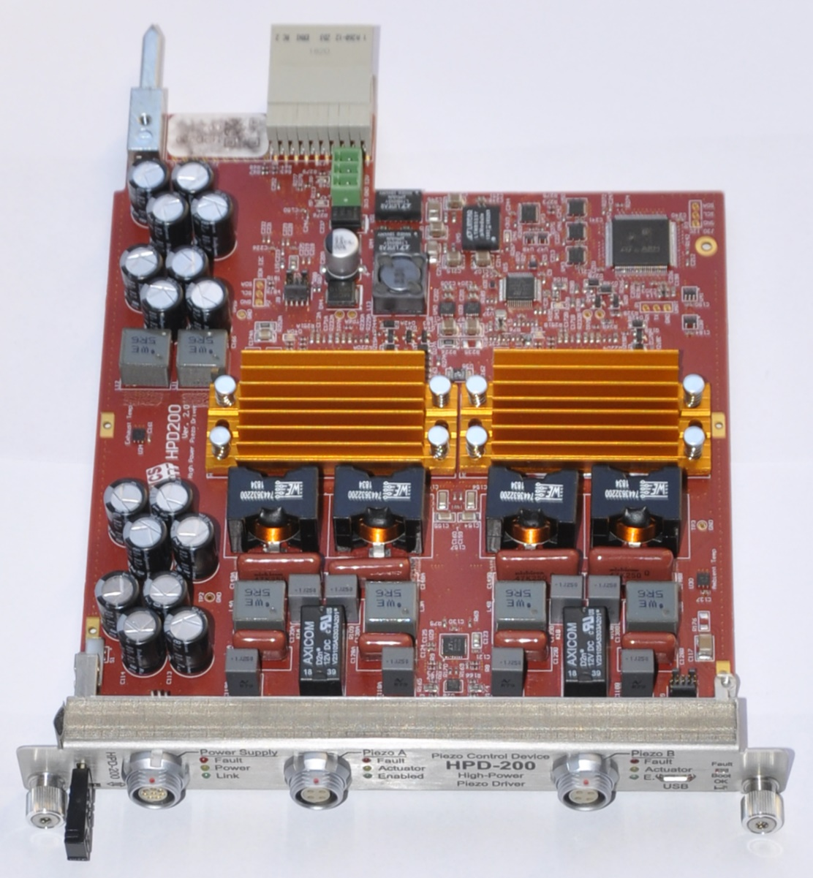
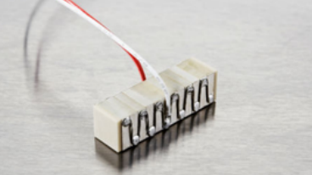
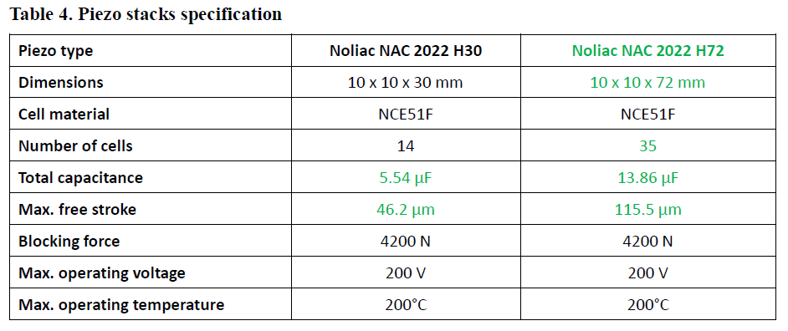
Cold Tuner System
Driver specification and Hardware
Developed by DMCS:
2 channel piezo driver for single cavity
Same HW for all SC cavities
External power supply to cover 0 to 180V output range
Parameter | Value | Comments
Form factor | MTCA.4 | Not fully compliant to MTCA.4 as RTM takes 2 slots
Number of channels | 2 bipolar | Actuator/sensor mode
Piezo capacitance | 1 uF to 5 uF | At cryo temperature
Repetition rate | ≤14 Hz | Pulse duration max 3.5 ms
Power supply voltage | ±100 V | External supply
Max dissipated power | 30 W per channel
Amplifier 3dB bandwidth | DC – 1 kHz
Actuator voltage range | Elliptical: 0 to +180 V Spoke: -47 to + 180 V | 1 MSa/s, 16-bits
Sensor mode | 1 MSa/s, 16-bits | Input impedance: 10 kΩ
Protection | Current, Voltage, Thermal | DAC level limits in EEPROM
Elliptical
Spoke

Slide 8




Cavity dynamics and detuning
Overview
Dynamics of cavity voltage:
Lorentz force detuning, mode k:
Time varying total detuning:
Compensation:
Algorithm with transfer function H:
$$δ=Hv^{piezo}+LFD(V)$$

Slide 9




Piezo algorithm
Offline characterisation
Done once of a cavity to determine w_{1/2} , C1 and L
Cables and equipment change amplitude and phase
Applying standard least square:
Iterative Learning Control (ILC):
L transfer function for channel A:

Slide 10
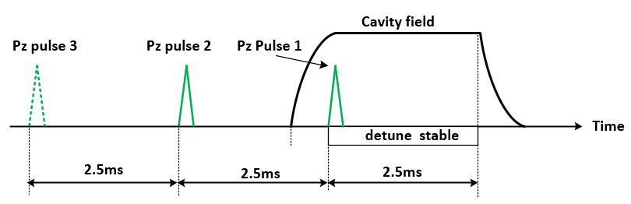
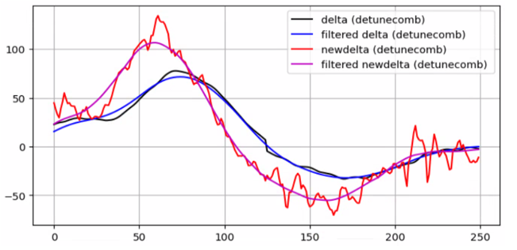

Characterisation 1(2)
Offline part
Applying Piezo pulses at low gradient
RF pulse width is limited to ~3.2 ms and by applying the actuator pulse in advance, observation time can be increased.
The resulting detuning is combined
Low pass filtering applied to remove high frequency content.
Detuning
Detuning – filtered
Detuning 2
Detuning 2 filtered
$$H(iw)=\frac{FFT(δ)}{FFT(v^{piezo})}$$
Pulse 1
Pulse 2

Slide 11
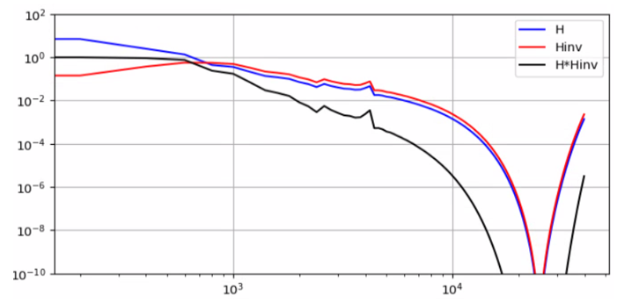

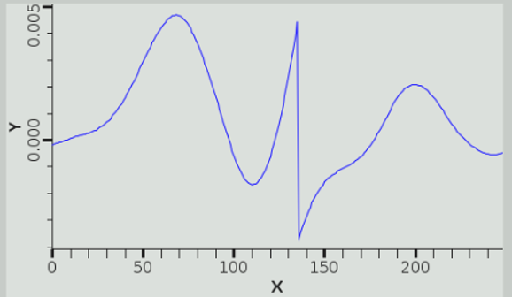
Characterisation 2(2)
Offline part
Inverse transfer function
where σ ensures small uncertainties in H give large incorrections in gains of L
In time domain:
The non-causal L(t) needs to be time shifted

Slide 12



Online part
For every pulse a new detuning needs to be calculated
To reduce noise dV/dt is calculated with linear regression over a sliding window.
Vreg is used to reduce noise sensitivity at low gradients
The algorithm acts on the difference of intended and estimated detunig, e(t)
Q(q) implemented as zero phase low pass filter
The online part runs at 50 kSa/s as detuning changes slowly

Slide 13
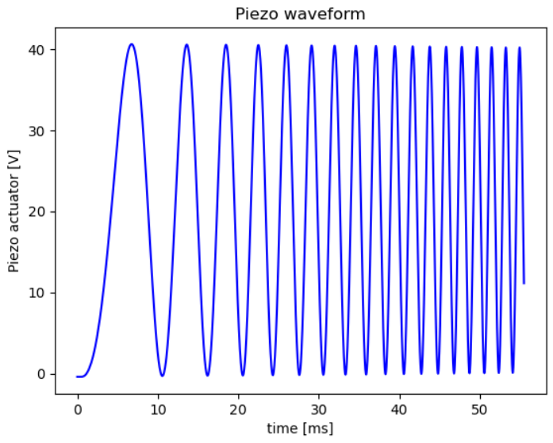
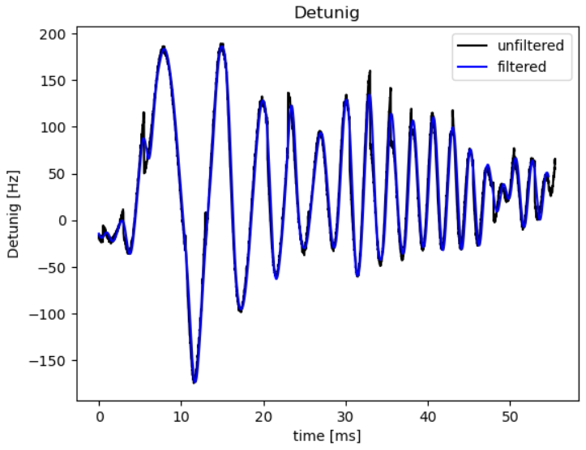
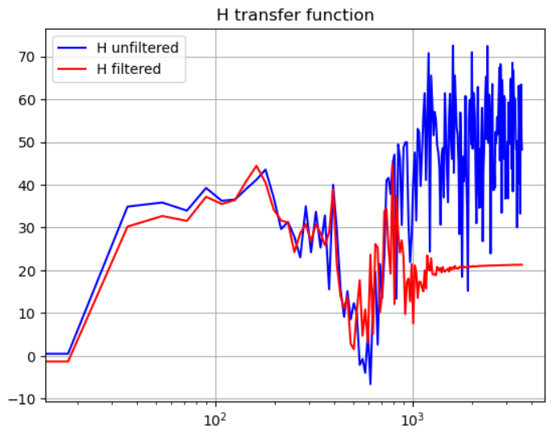
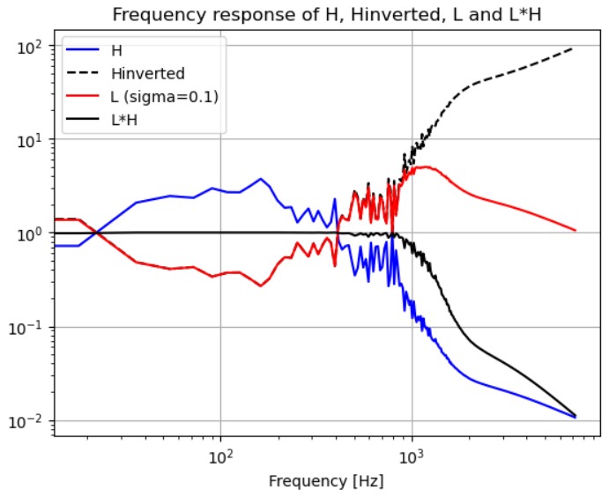
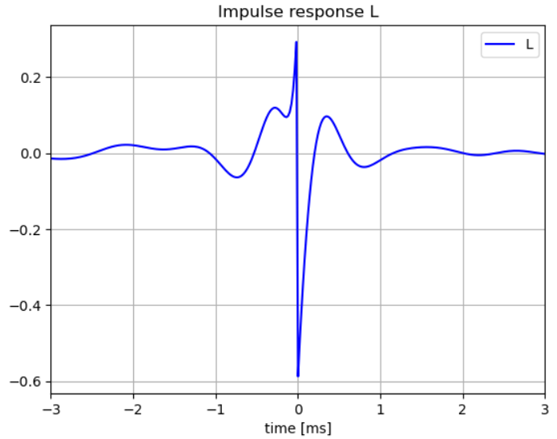
Chirp
Alternative characterisation method
An alternative to impulse response
Chirp from 25 Hz to 600 Hz
In pulses of 2.5 ms
Gives a different shape of L
Not yet fully tested in online part

Slide 14
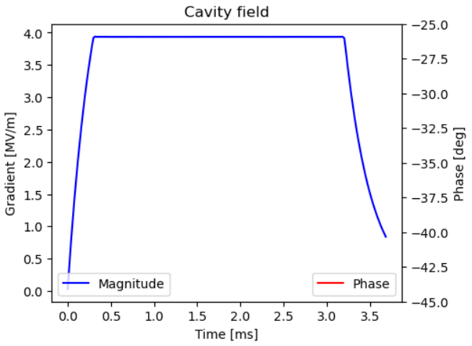
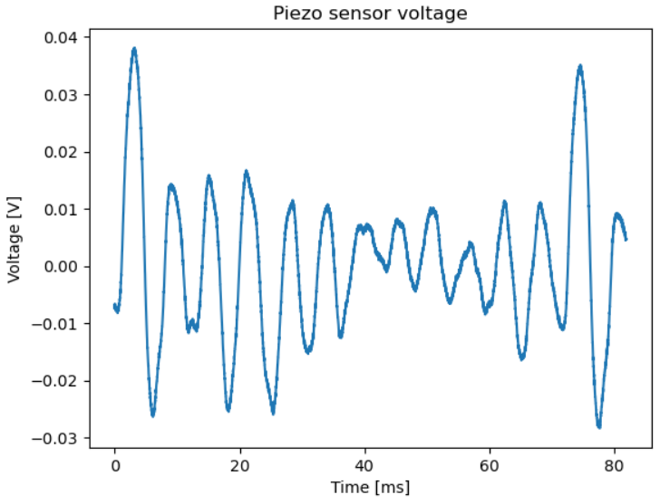
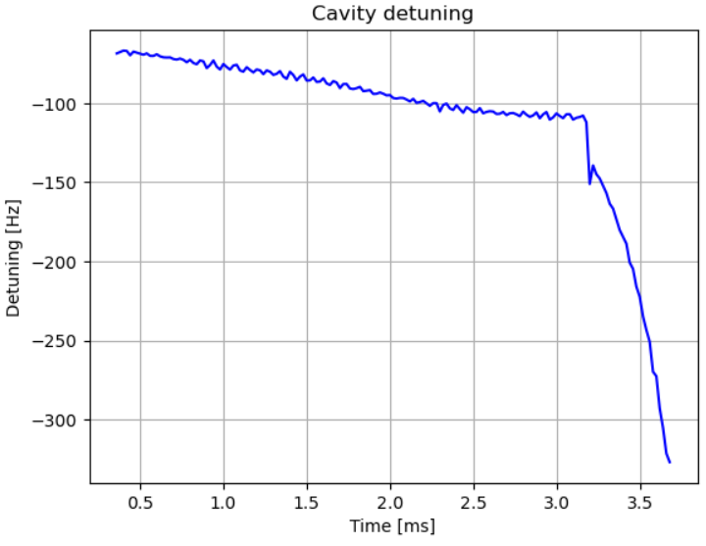
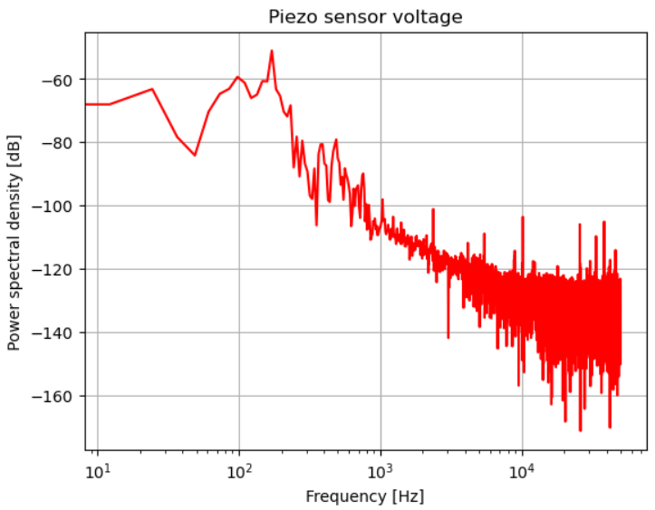
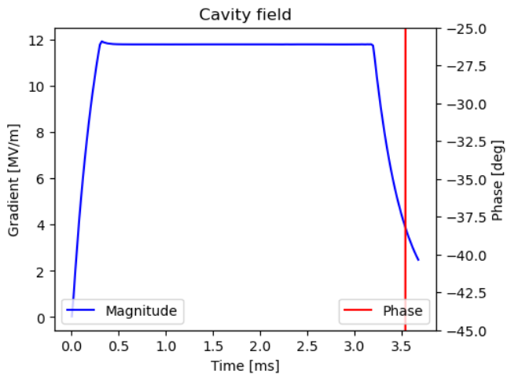
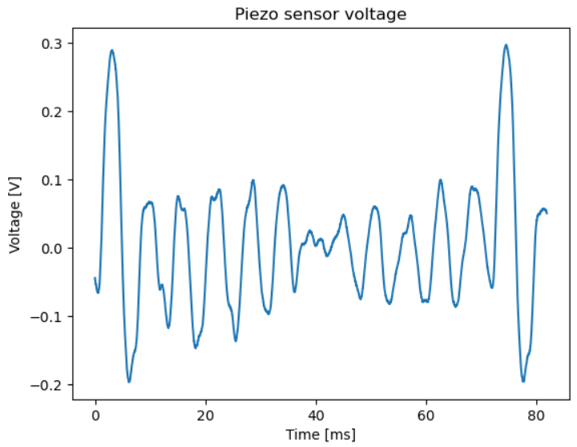
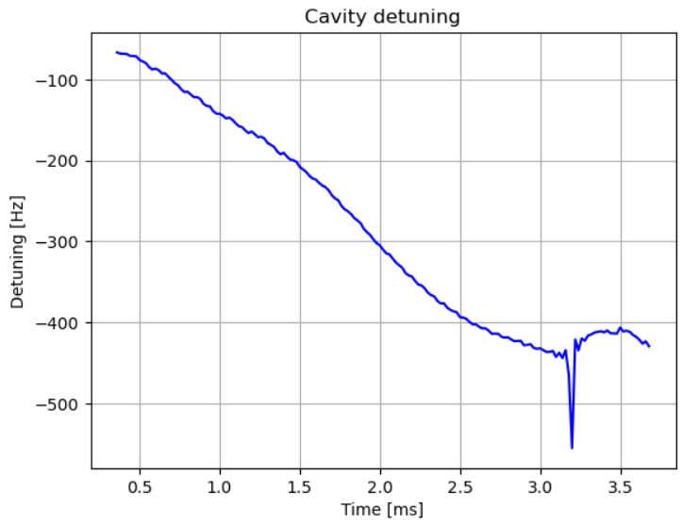
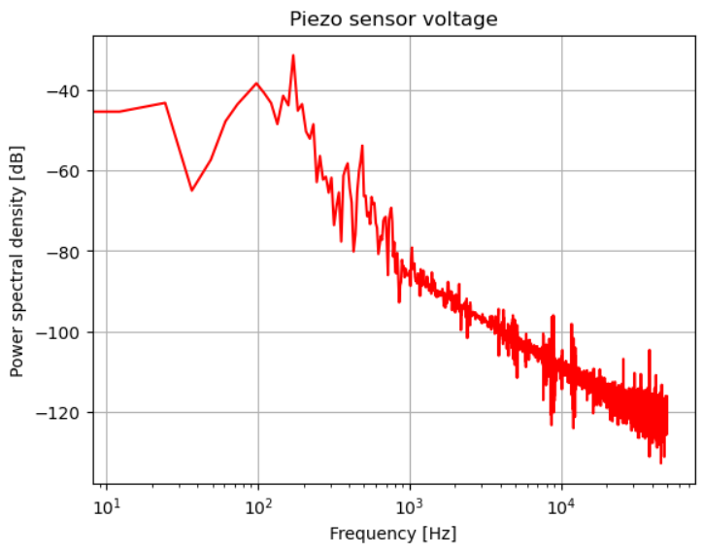
Mechanical modes
4 MV/m and 12 MV/m
With long Piezo sensor acquisition time mechanical modes was observed
4 MV/m
12 MV/m

Slide 15
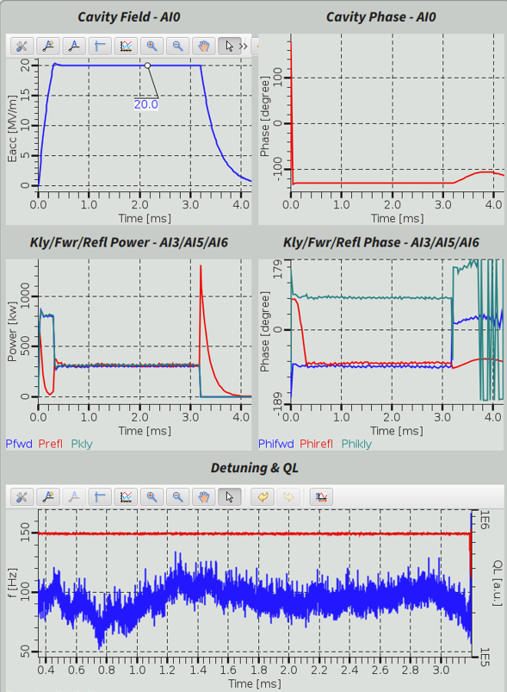
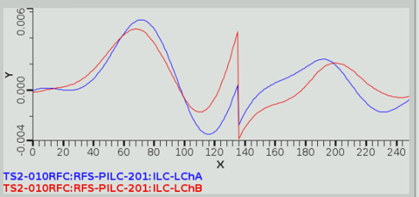
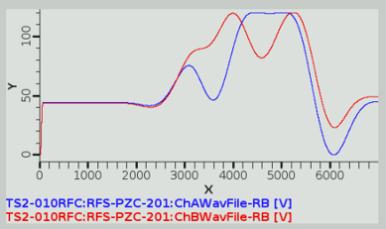
Results
”Normal” cavity
HB cavity at 20MV/m
Cavity tuning sensitivity: 2-3 Hz/V
Setpoint: 100 Hz
L functions:
Piezo voltages:

Slide 16
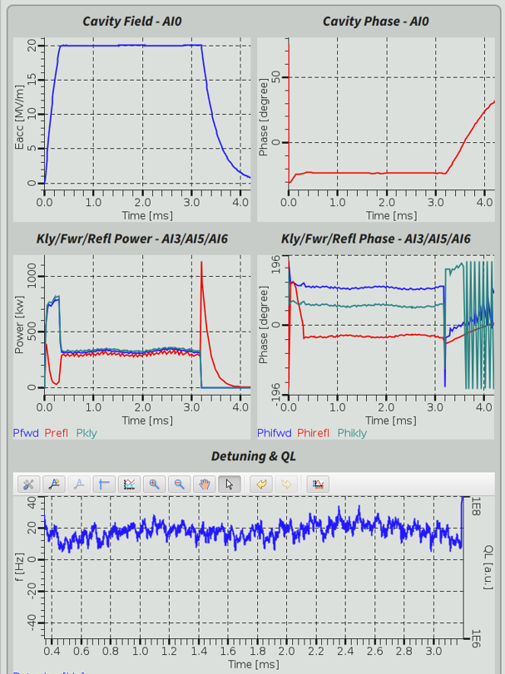
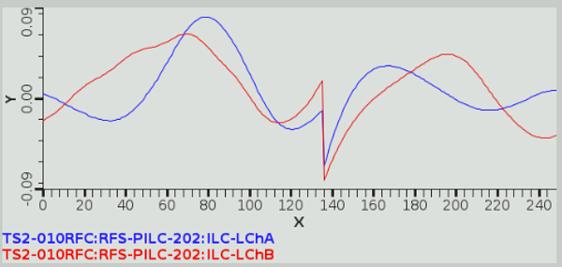
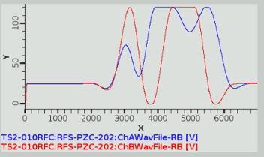
Results
”Stiff” cavity
HB cavity at 20 MV/m
Cavity tuning sensitivity only 0.23 Hz/V
Setpoint: 20 Hz
L functions:
Piezo voltage:

Slide 17
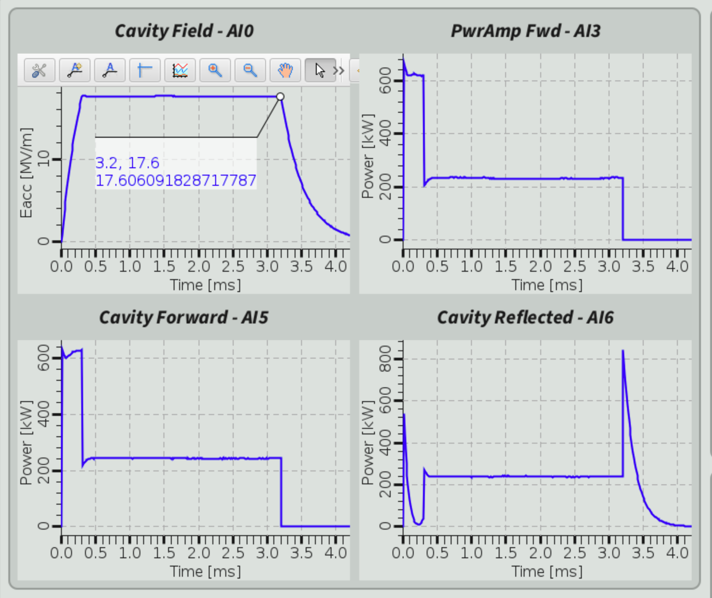
Performance with and without Piezo
Piezo OFF
Cavity detuning at high field (LFD) requires > 50% extra power at pulse end!
Piezo ON
FB loop overpower 1 BW = 2x power
Flat pulse with FB

Slide 18
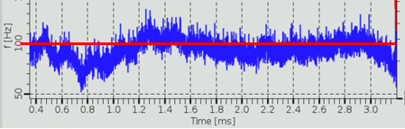
Summary and outlook
Only few cavity tested so far but results looks promising.
More testing needed to optimise performance
Further Improvements:
Detuning calculation is quite computational heavy and noisy
Reduce sample rate and add filtering
Allow longer observation time for transfer function
Trigger limitation
Evaluate characterisation with chirp method

Slide 19
Contributors
Contributors at Lund University:
Bo Bernhardsson, Prof. Department of automatic control
Anders J. Johansson, Associate Professor at EIT
Contributors and DMCS in Lodz:
Wojciech Cichalewski, PhD and team lead
Contributors at ESS:
Mateusz Nabywaniec, IOC implementation
Cecilia Maiano, Teststand coordination
And many more

Slide 20
Thank you!

